Slide 1

Bangladesh University of Business and Technology
A Presentation on
Online Streaming Platform
“Cine-Bilash”

Slide 2


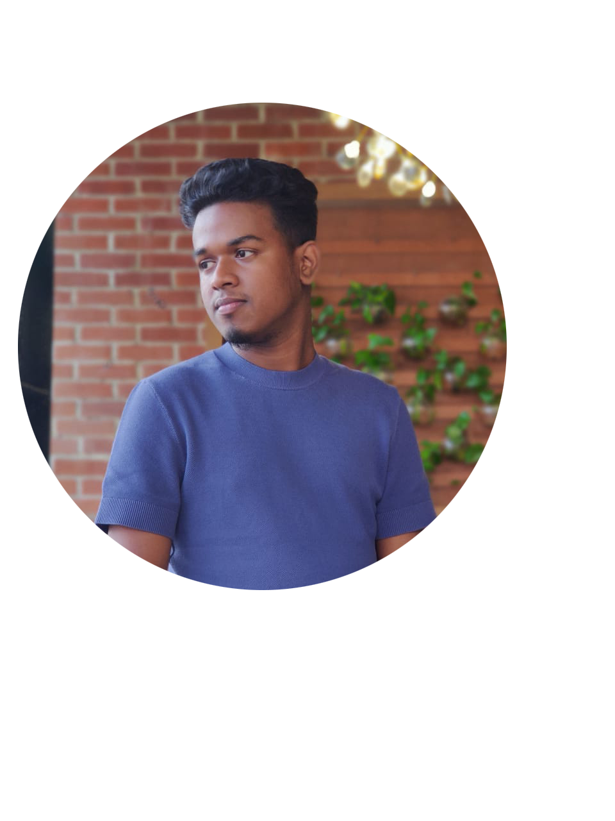
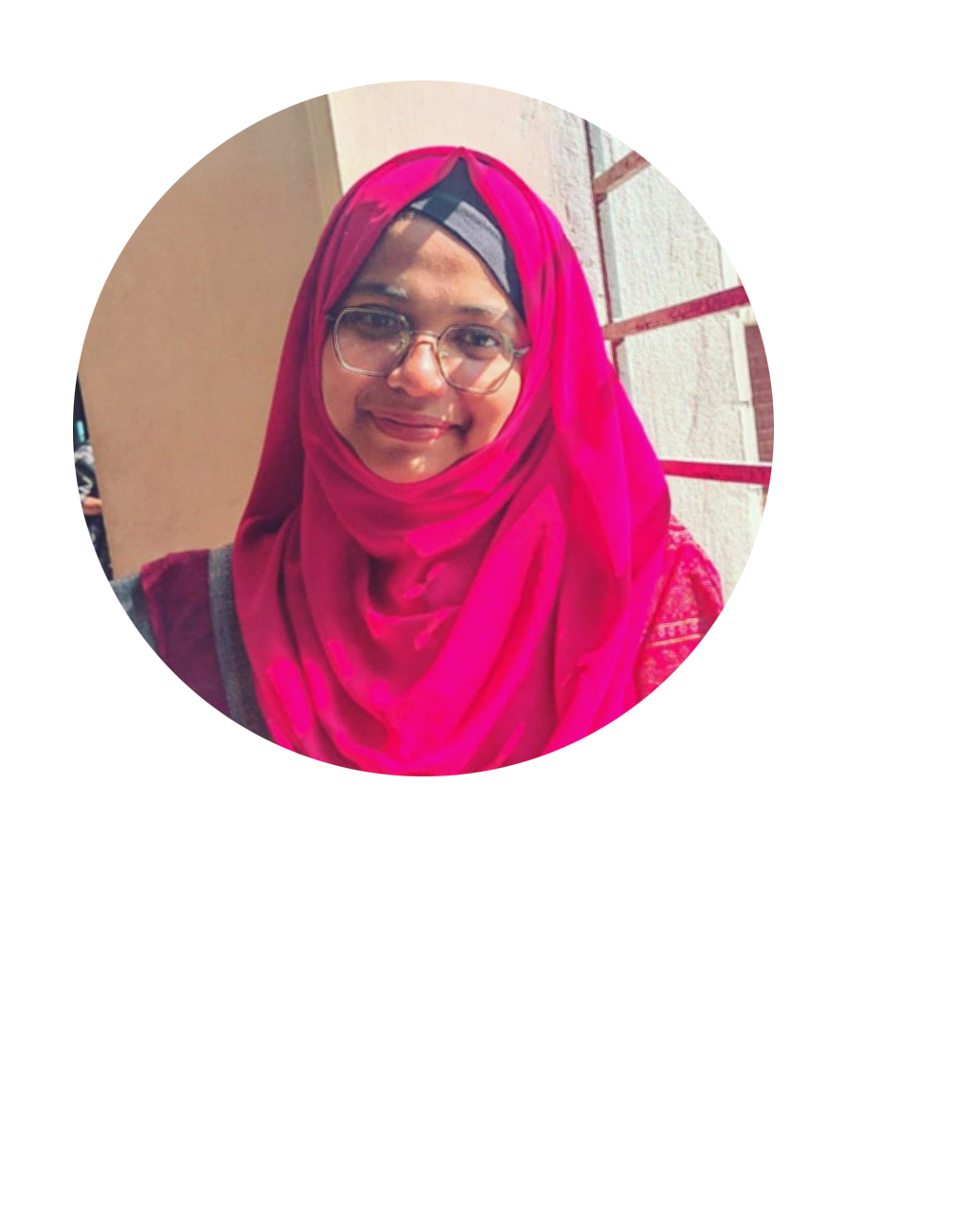
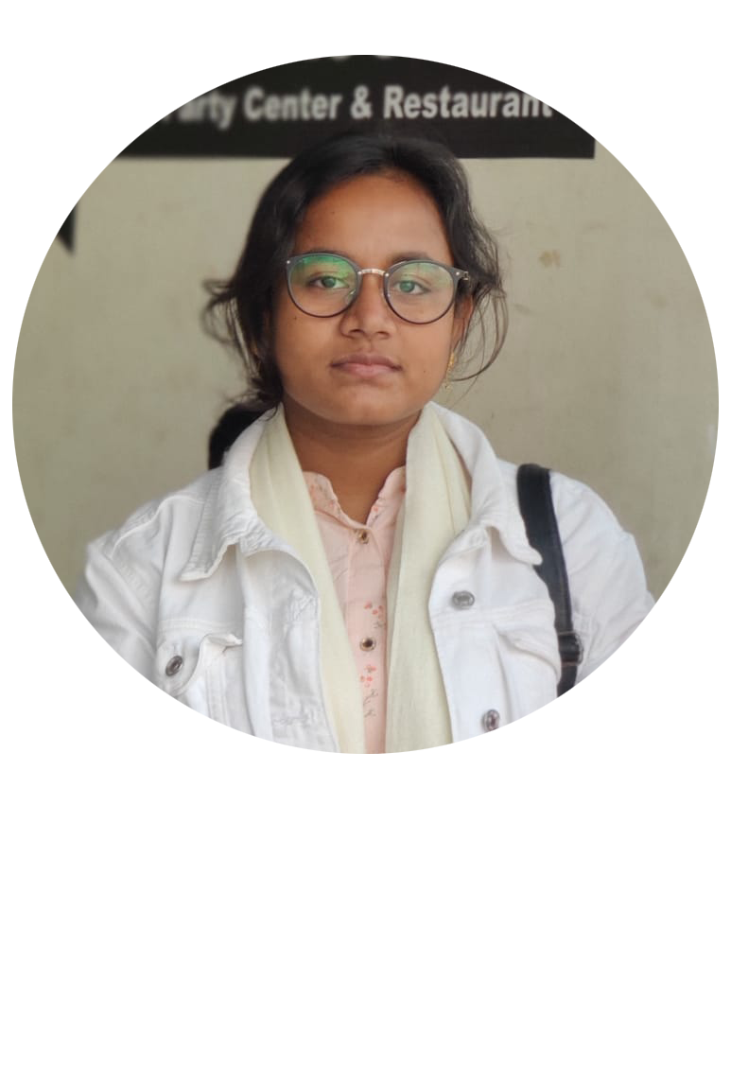

Team : Diagon-Alley
Team Members
Md. Rashadul Islam
Md. Faysal Mahmud
Sadia sultana
Dipa Rani
Latiful Islam Shoisob
Id: 19202103169
Id: 19202103174
Id: 19202103184
Id: 19202103201
Id: 19202103162
Supervised By
Mr. Ali Azgar
Assistant Professor
Department of CSE, BUBT

Slide 3
Outline
Introduction
Literature Review
Motivation
Objective
Requirements
Proposed Model
Implementation & Result Analysis
System User
Conclusion & Future Work
References

Slide 4
1. Introduction
An OTT streaming platform is a website or application that allows users to
access a variety of video and audio content on demand.
Users can watch movies, TV shows, documentaries, music videos, live events,
and other types of content.
The platform can be accessed on multiple devices personalized recommendations
based on users' viewing history and preferences.
The platform may have limit access to certain types of content in-terms of
subscription based users.[1]

Slide 5

2. Literature Review
Online streaming platforms have grown in popularity
Younger generations are more likely to use online streaming platforms than
traditional TV.
Original content on online streaming platforms is a major driver of user engagement.
Increased competition in the industry with new platforms entering the market.

Slide 6
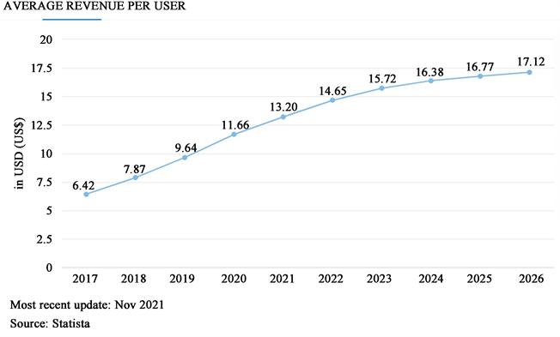
Rapidly Increment of OTT Streaming Platform now days
Figure – Growth of OTT

Slide 7



3. Motivation
Fig - Some Popular OTT Platform in Bangla [2] [3] [4]
No Preview system before login
Subscription cost matters

Slide 8

4. Objectives
provide a user-friendly platform that offers easy navigation and a seamless
user experience with very low cost subscription.
Offer a vast collection of high-quality video on demand, including movies, TV shows, documentaries, and live events.
Giving a preview to the users before registration
24/7 customer support

Slide 9
5. Requirements
Hardware Requirements
Ram – Minimum 2 GB (for smoothly run a browser)
A good internet connection
Software Requirements
A compatible Browser
OS

Slide 10

6. Proposed Model
For the better understanding we have divided the proposed Model into two section [5]
UML Diagram
Use Case Diagram
Activity Diagram
ER Diagram

Slide 11
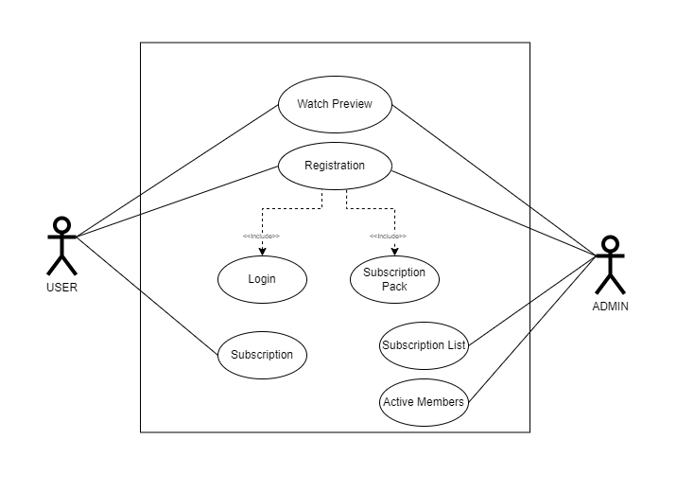
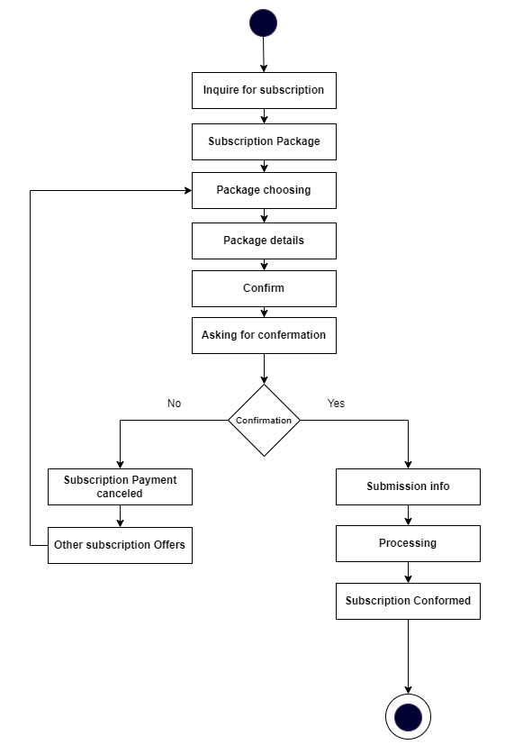
6.1 UML DIAGRAM
Figure - Use Case Diagram
Figure – Activity Diagram

Slide 12
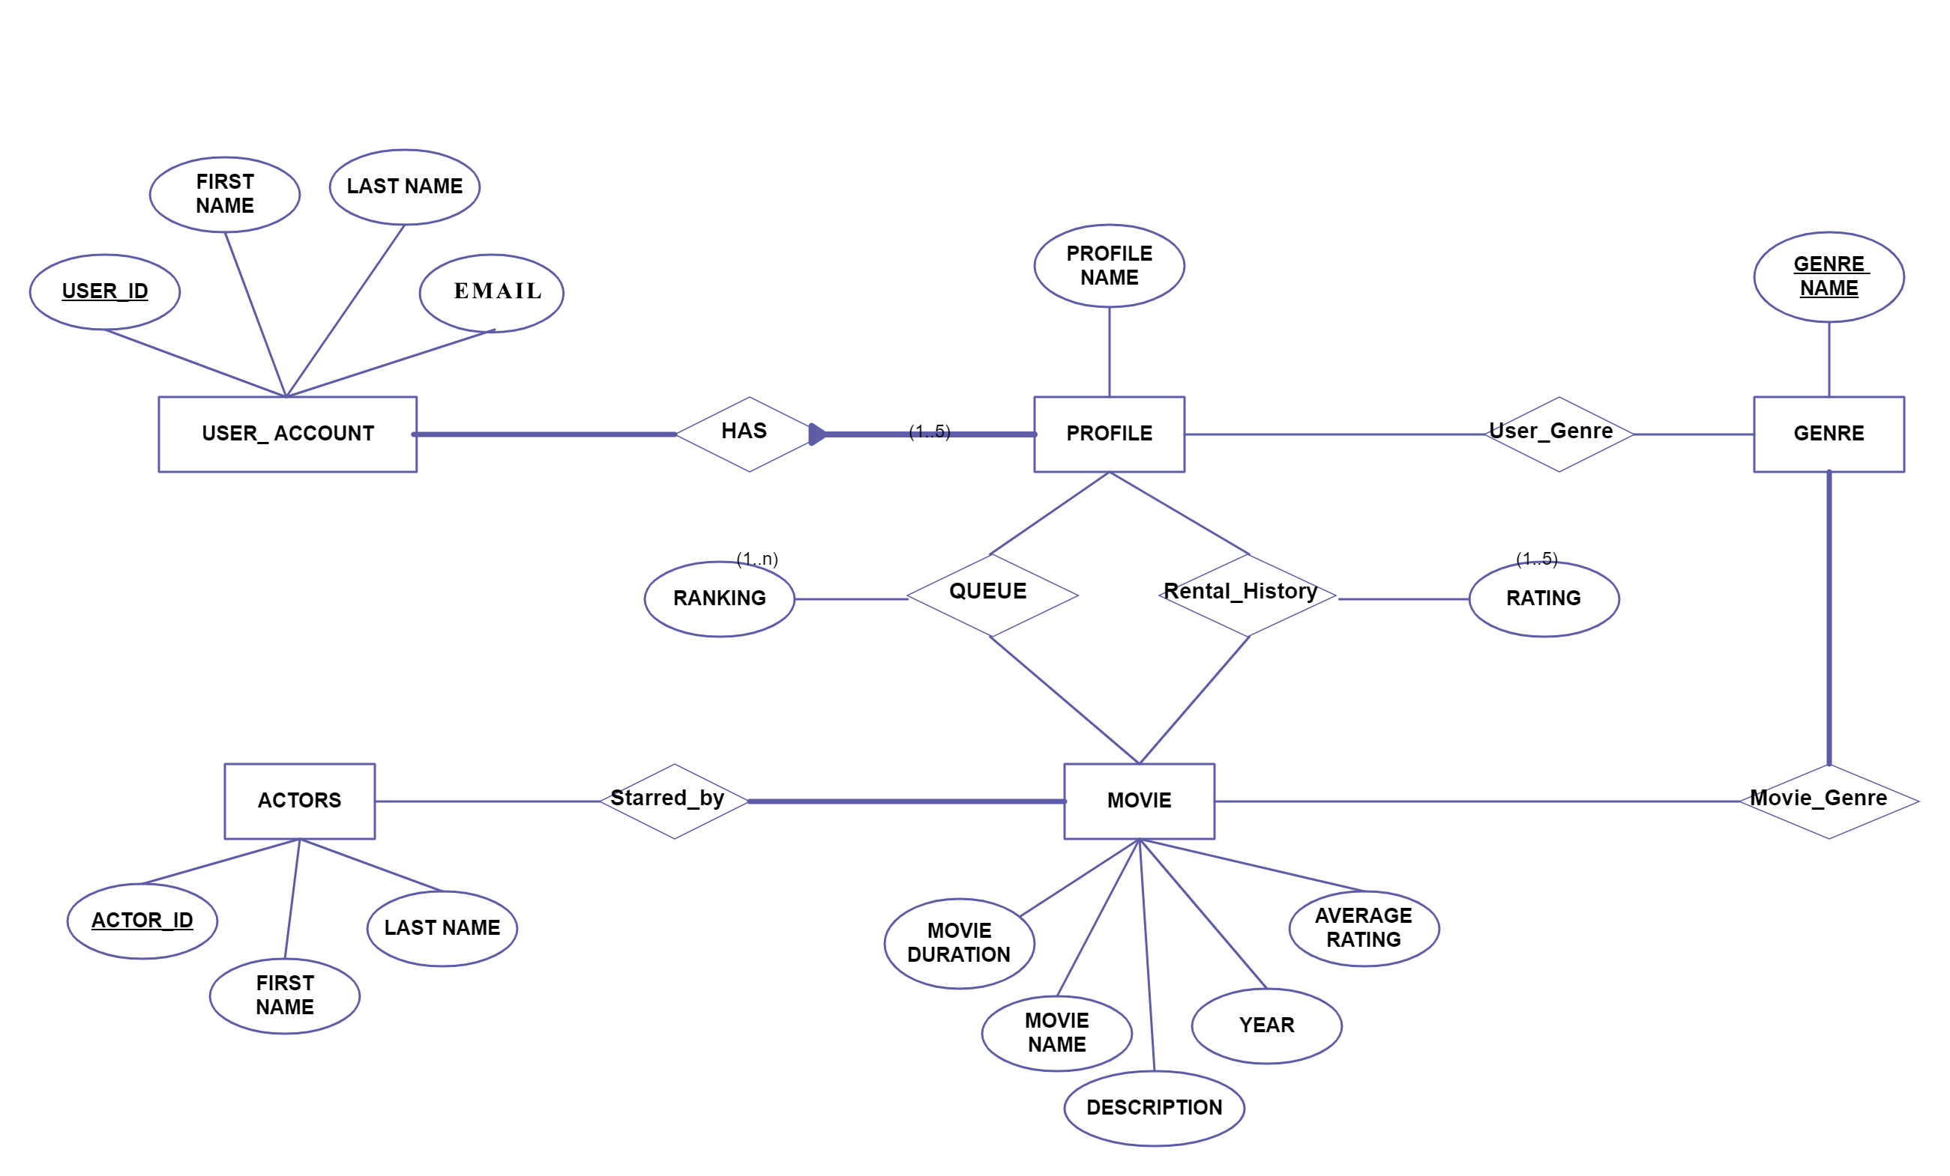
6.2 ER DIAGRAM
Figure – ER Diagram

Slide 13
7. Implementation & Result Analysis
For the better understanding we have divided the Implementation & Result
Analysis into Three part:
Front End
Back End
Database

Slide 14
7.1 Front End & Back End

Slide 15
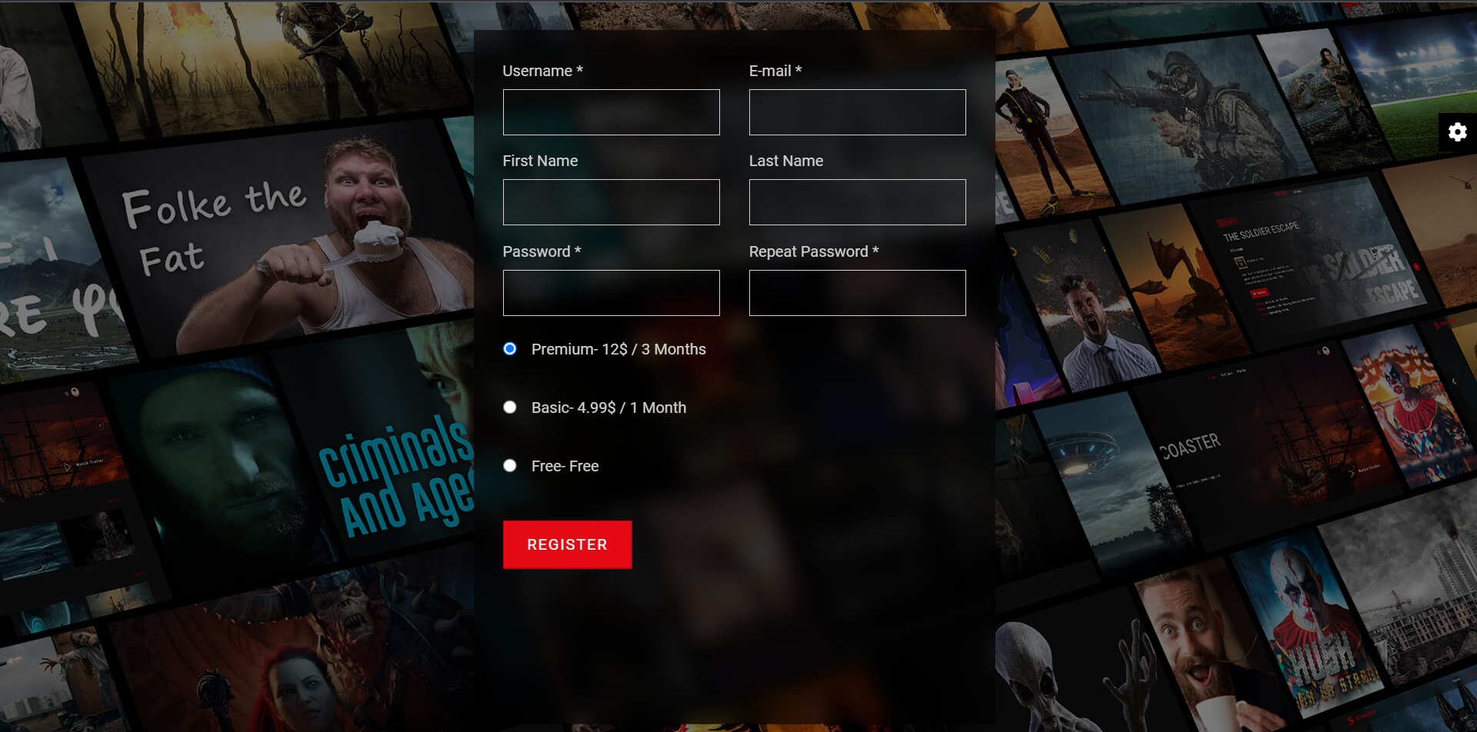
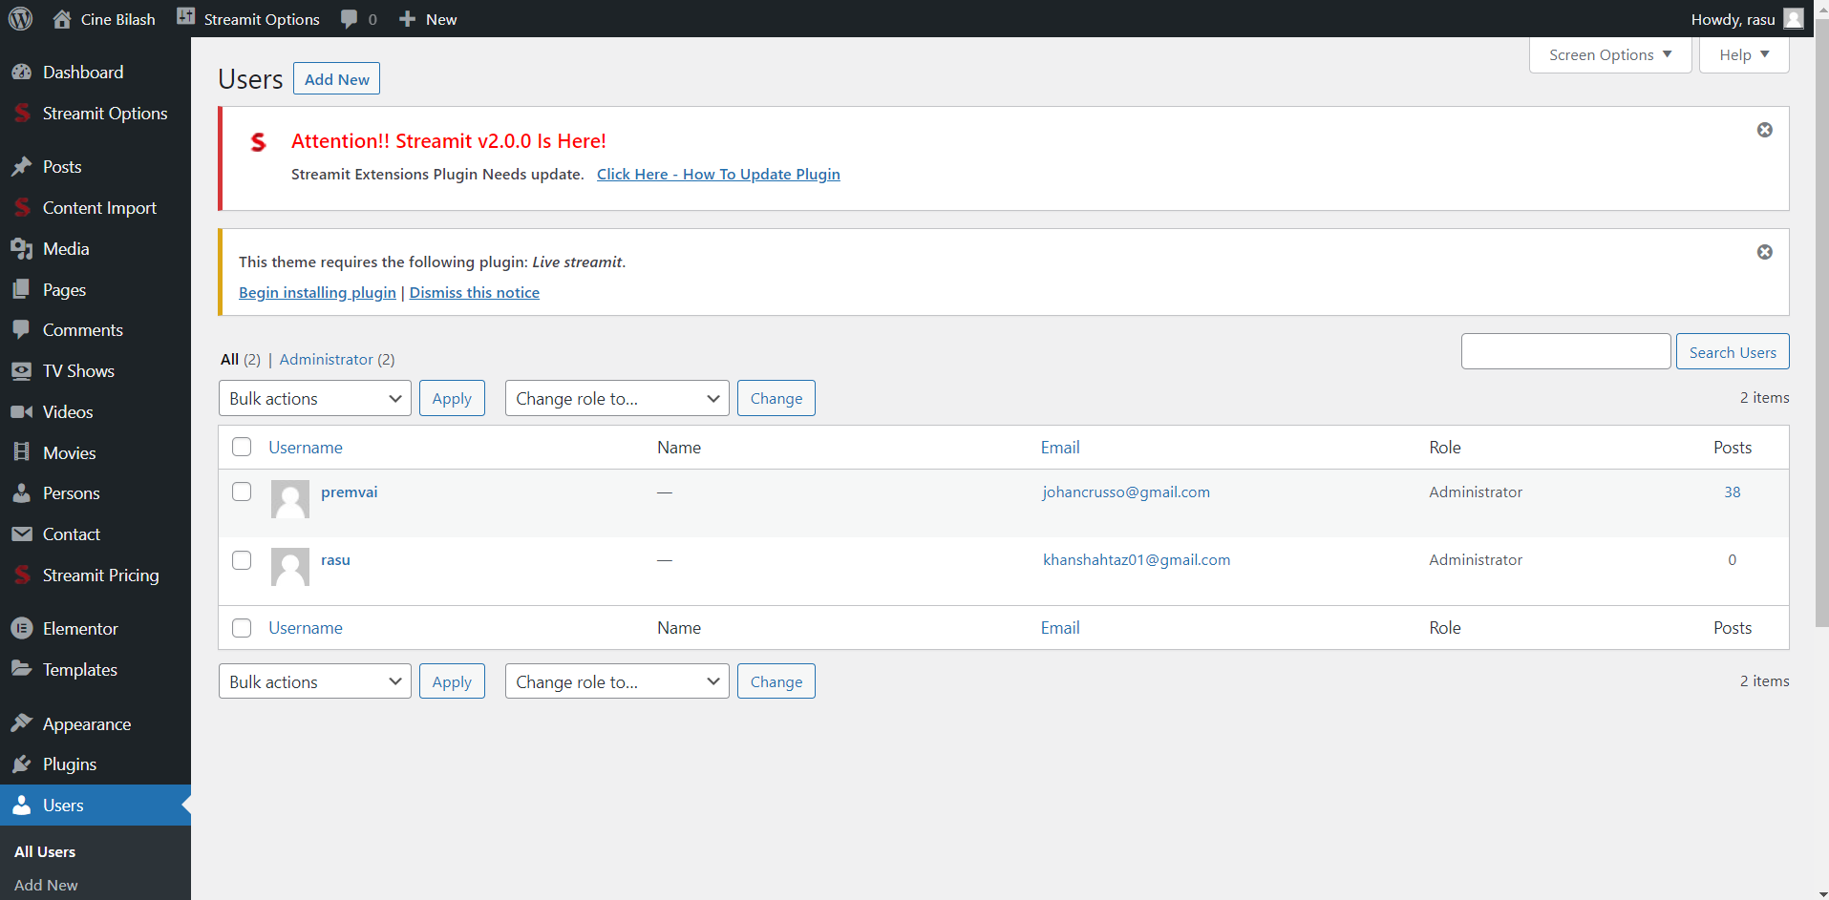
Figure – Registration Page Front End
Figure – Registration Page Back End

Slide 16
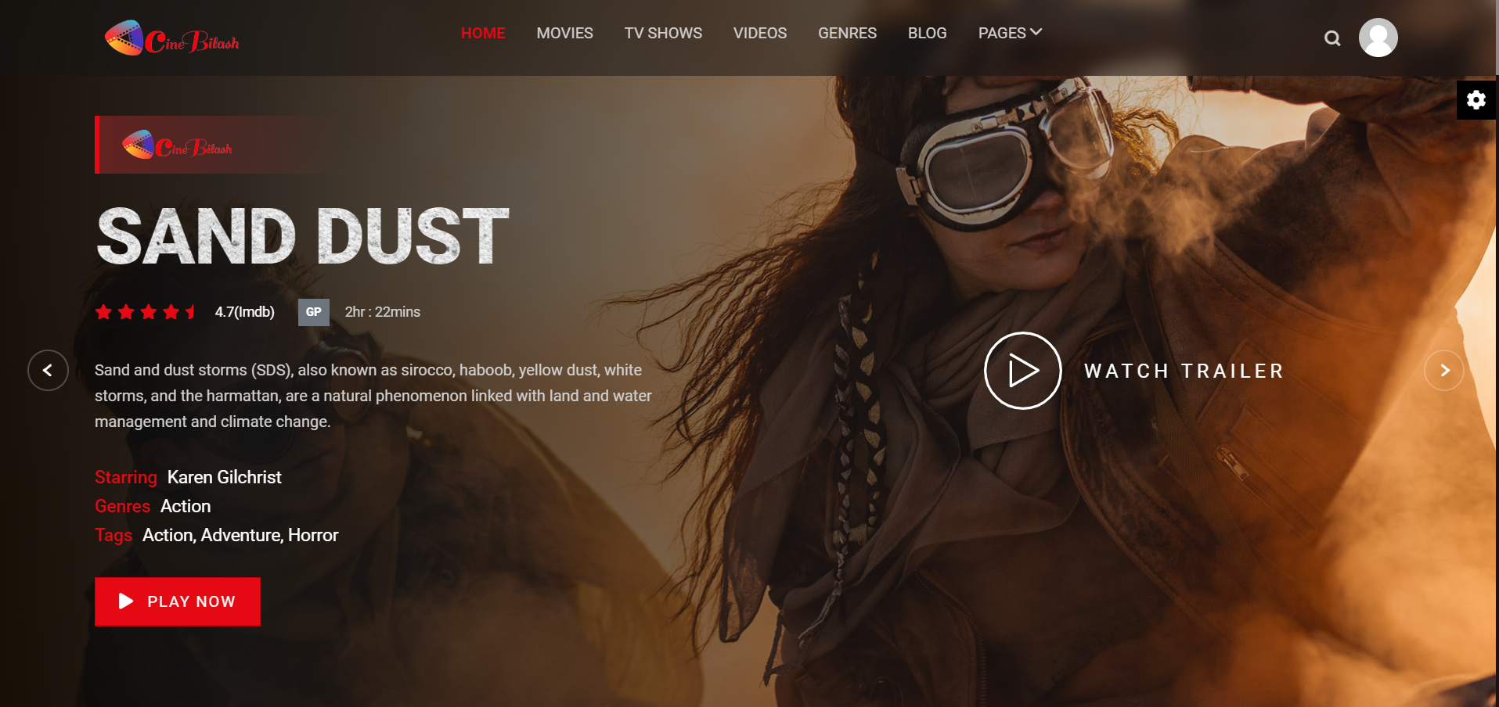
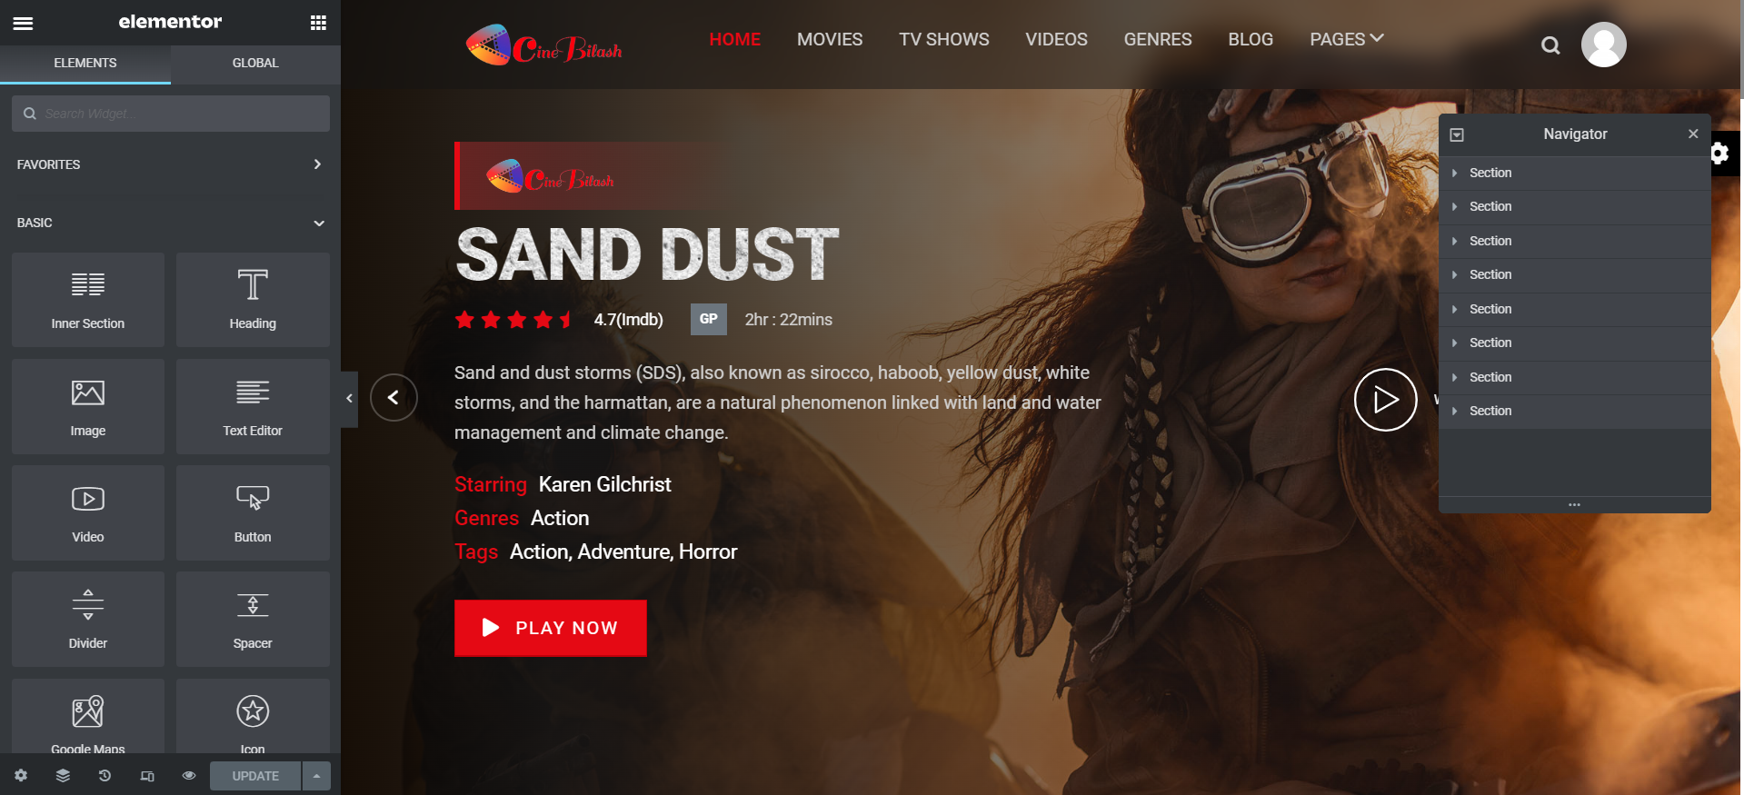
Figure – Home Page Front End
Figure – Home Page Back End

Slide 17
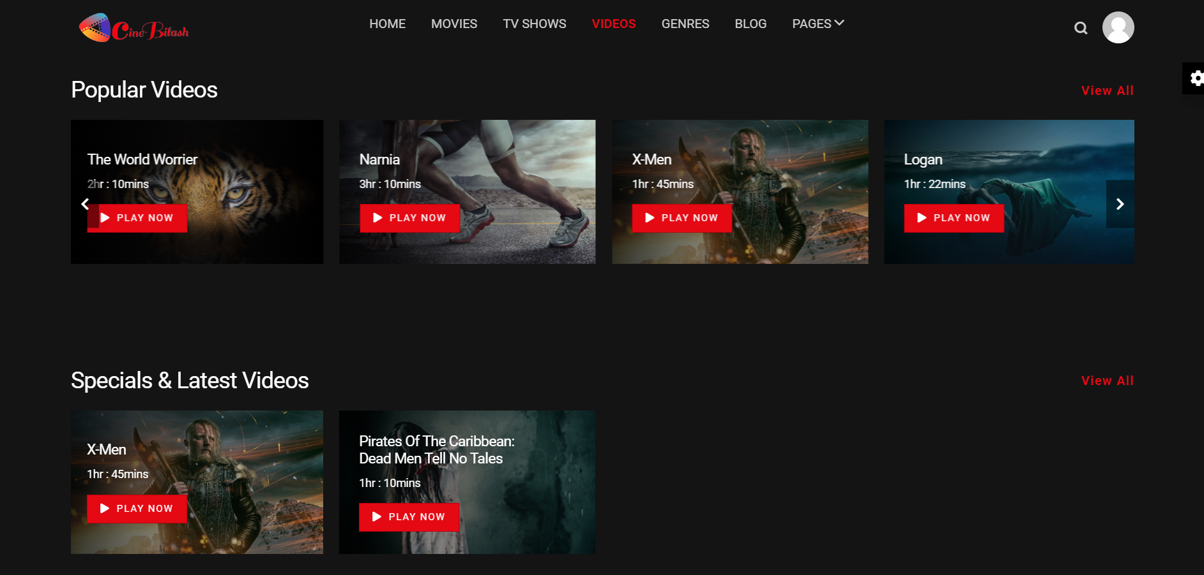
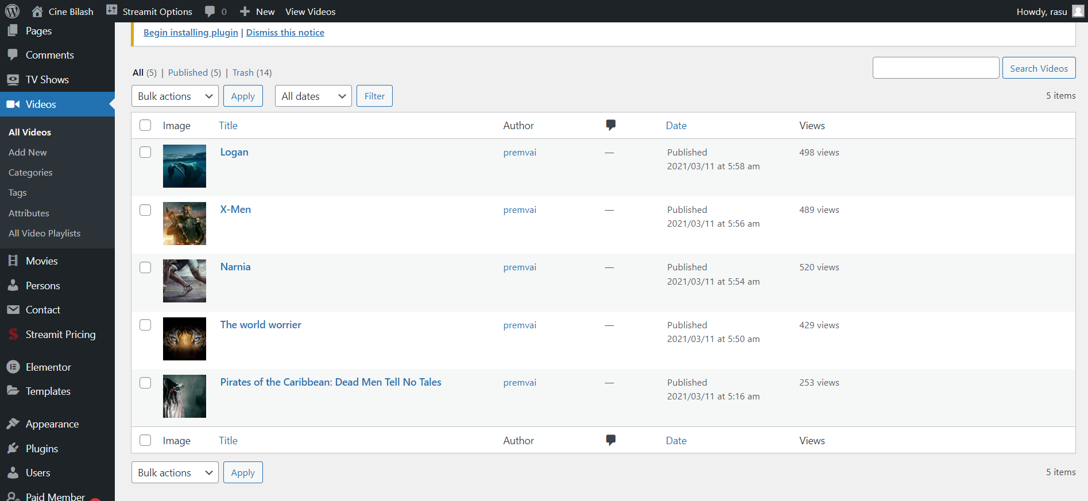
Figure – Video Page Front End
Figure – Video Page Back End

Slide 18
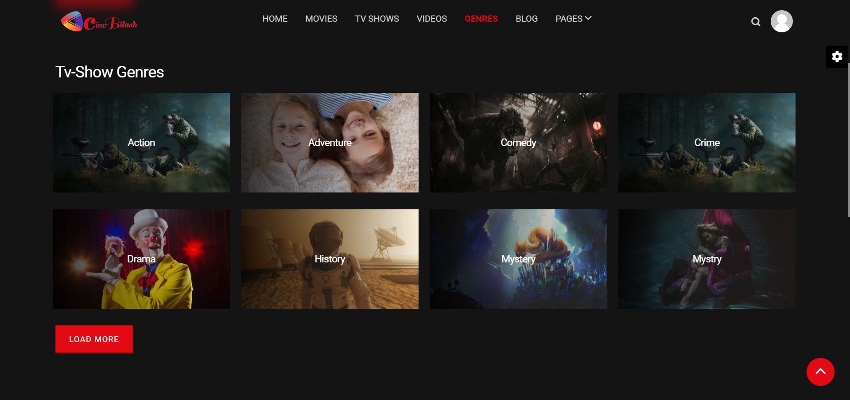
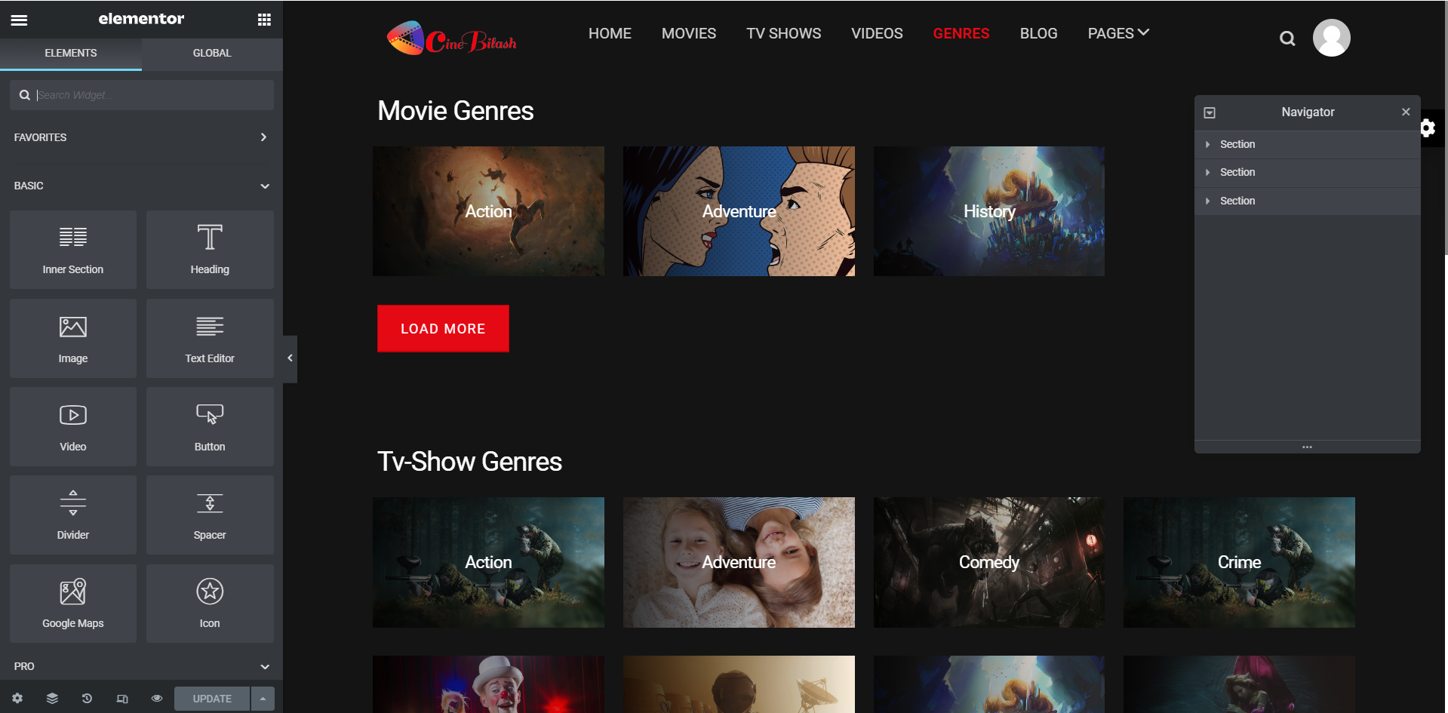
Figure – Genres Page Front End
Figure – Genres Page Back End

Slide 19
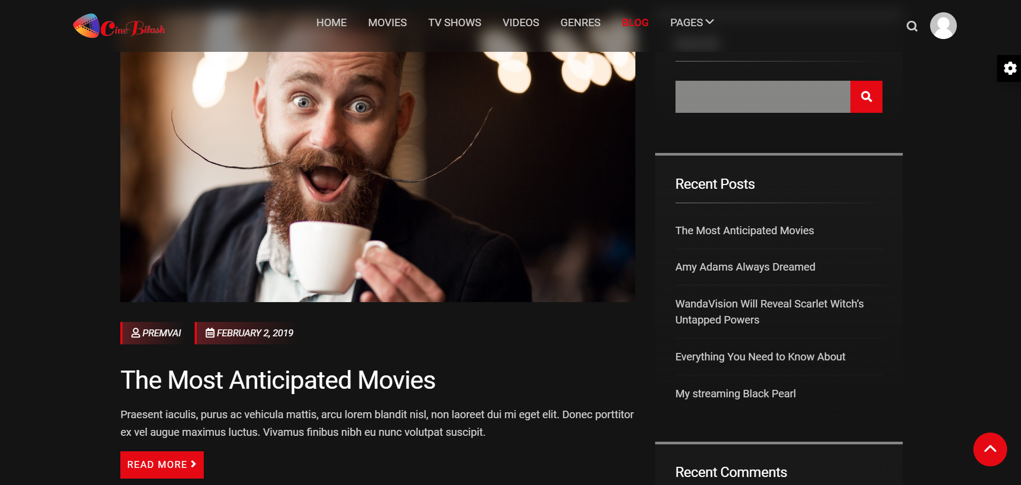
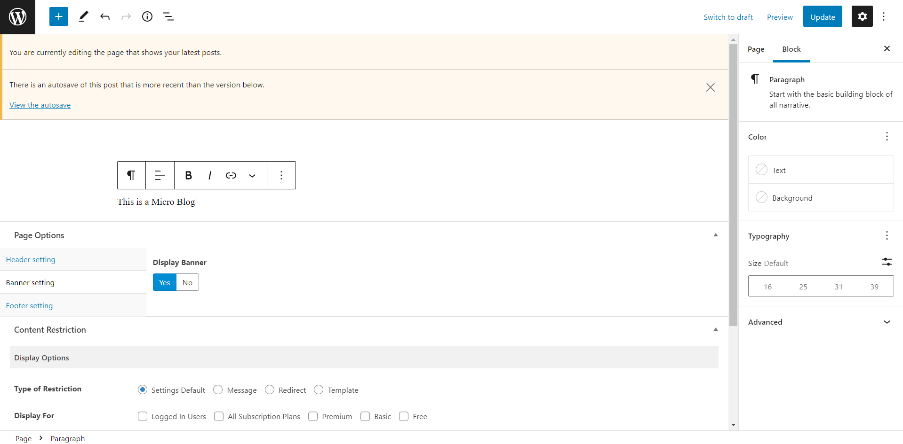
Figure – Blog Page Front End
Figure – Blog Page Back End

Slide 20
7.2 Database Tables

Slide 21
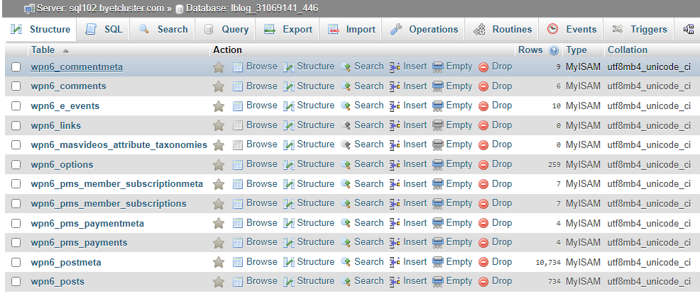
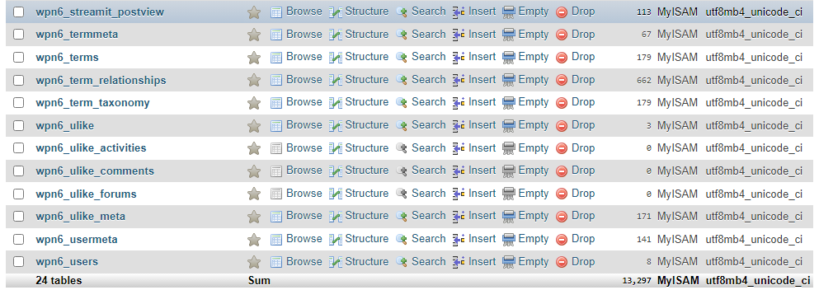
Figure – Database Tables

Slide 22
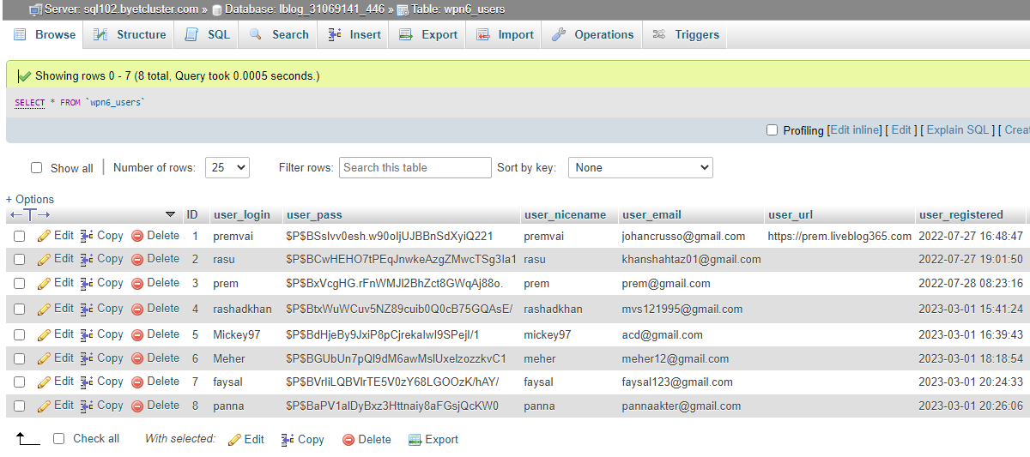
Figure –User Database Table

Slide 23
8. System Users
Users
Free User – will be able to stream but to a certain limitation
Premium users (weekly, monthly & yearly) – will be able to stream premium contents in exchange of a certain amount of cost.
Admin
In our system admins are also user. They can access any contents , update, edit and so on.

Slide 24
9. Conclusion & Future Work
Online streaming platforms have disrupted traditional television and media consumption
habits, offering a convenient and cost-effective alternative.
Original content and personalized recommendations have driven user engagement
and loyalty.
In future we will increase contents and our own Mobile App will be available very soon
We will add Mobile Banking system very soon right now it’s in maintenance

Slide 25
10. References
[1] Falkowski-Gilski, P., & Uhl, T. (2020). Current trends in consumption of multimedia content
using online streaming platforms: A user-centric survey. Computer Science Review, 37, 100268.
https://doi.org/10.1016/j.cosrev.2020.100268
[2] ZEE5. (2023). Retrieved from https://www.zee5.com/
[3] Chorki. (2023). Retrieved from https://www.chorki.com.bd/
[4] Bioscope. (2023). Retrieved from https://www.bioscopelive.com/en
[5] Datta, H., Knox, G., & Bronnenberg, B. J. (2018). Changing their tune: How consumers’ adoption
of online streaming affects music consumption and discovery. Marketing Science, 37(1), 5-21.
https://doi.org/10.1287/mksc.2017.1066

Slide 26
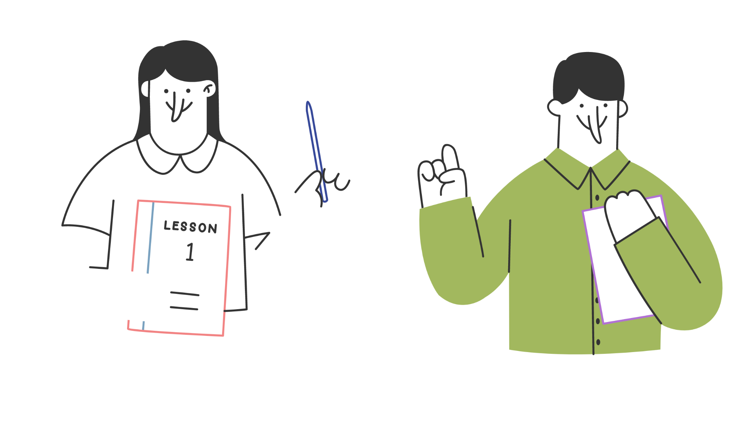
Thank you!

